Slide 1
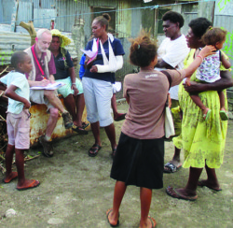
Vanuatu
World Day of Prayer 2021

Slide 2

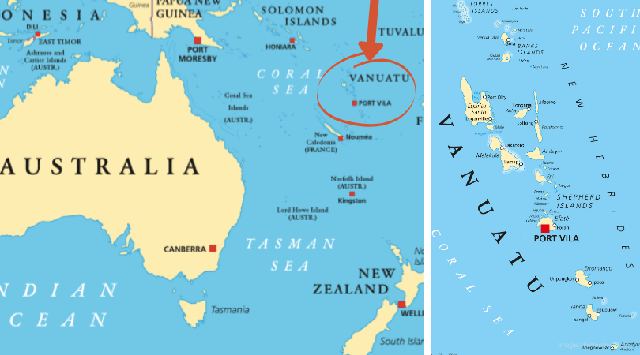
Vanuatu is an archipelago of about 80 small islands to the Northeast of Australia. About 65 islands are inhabited.
There are about 300,000 inhabitants on the islands. Citizens of Vanuatu are referred to as Ni Vanuatu or Ni Van. They speak Bislama, English and French.

Slide 3
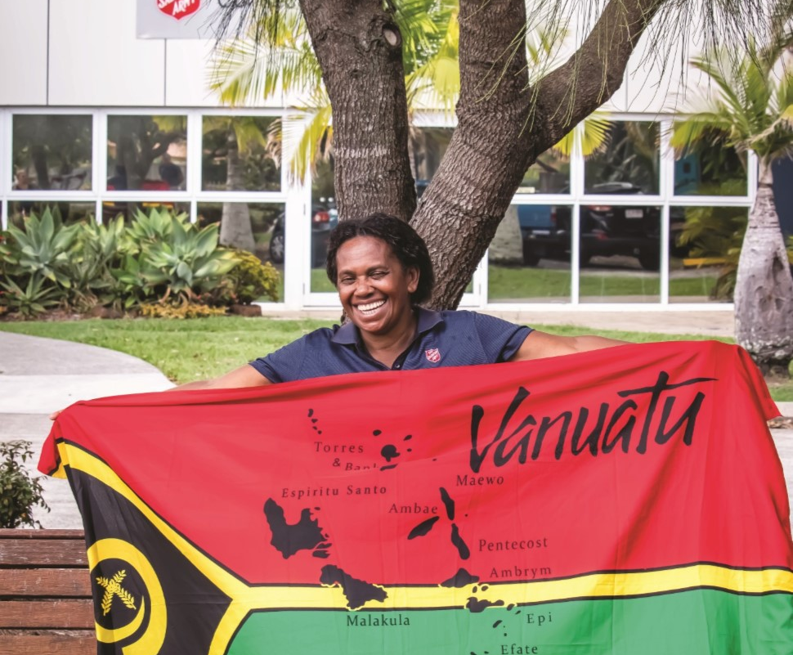
History
- Lilyrose Sarilobani and her husband began caring for orphaned and vulnerable children in their neighborhood many years ago. She heard about The Salvation Army and thought their ministry seemed to be in line with The Army’s mission.
- Salvationist visitors from Australia connected with Lilyrose on one of their visits and a partnership developed.
- Today Lilyrose continues her care of vulnerable children while also running an Outpost, and Salvation Army ministries in her city.

Slide 4
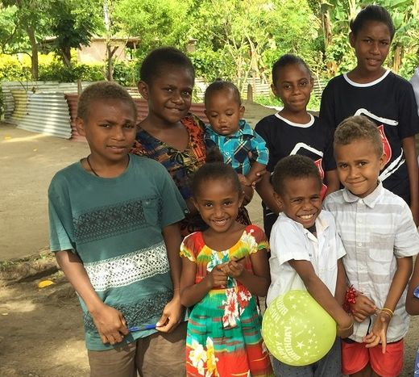
Social Services
-The Lilyrose and William Sarilobani live and minister in a neighborhood called: “21 Jump Street”
-The Sarilobanis care for at least 12 children providing food, shelter and education.
-When anyone in their community is in need, they come to the Sarilobanis and The Salvation Army for help.

Slide 5
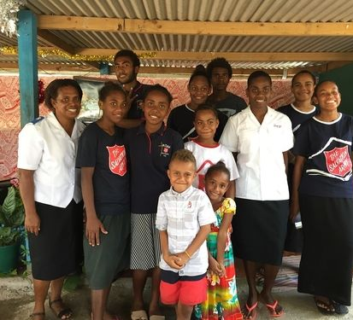
Corps Ministry
-There are three outposts, in the capital city of Port Vila (“21 Jump Street”), in Aneitiyum (on a southern island) and in Erromango.
-There are over 20 Senior Soldiers and 50 Junior Soldiers enrolled so far!
-In Port Vila, they have worship time 6 days a week, with singing, and Bible teaching.

Slide 6
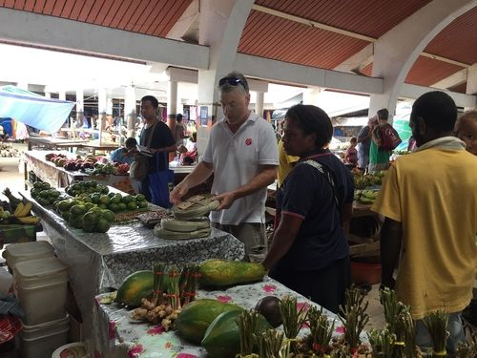
Disaster Services
- One of the main outreach avenues The Salvation Army has had in Vanuatu is Disaster relief.
- Following Cyclone (Hurricane) Pam in 2015, The Army provided immediate relief of food and clean water, and over time, helped rebuild 15 homes, and establish new water sources.

Slide 7
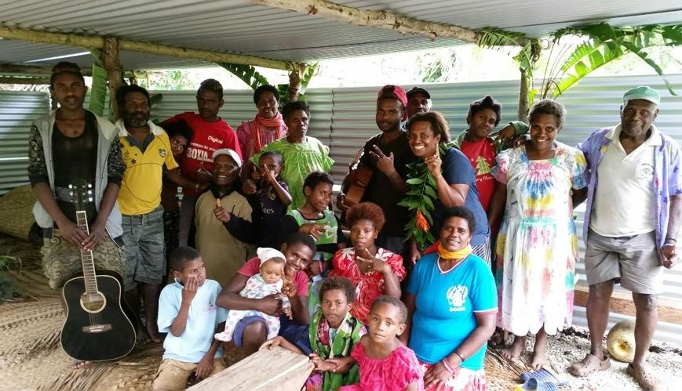
Interesting facts of The Salvation Army in Vanuatu
- The Salvation Army is not yet officially recognized/registered in Vanuatu. This is still a pioneer work.
- It is operating in partnership with the Tweed Heads corps in Australia.
-Additional ministries include: Prison Ministry, Women’s Ministries, fundraising efforts, and social services.

